Slide 1

Fabrication and Testing of V2O5 and WO3 based Memristors
Memristors are a promising new electronic component
with the ability to remember and process information.
This introduction will explore the fabrication and testing of
vanadium oxide (V2O5) and tungsten oxide (WO3) based
memristors, which exhibit unique resistive switching
properties.

Slide 2
Abstract
This work investigates the fabrication and characterization of
V2O5 and WO3 thin film memristors. The materials are
deposited using advanced techniques and their resistive
switching behavior is analyzed in detail. The findings
demonstrate the potential of these metal oxides for n
ovel memory and neuromorphic computing applications.

Slide 3
Introduction
Memristors are a unique class of electronic devices that can remember their past states and exhibit variable resistance based on the history of applied voltages and currents. This introduction explores the fundamental operating principles and recent advancements in memristor technology, setting the stage for the new findings presented in this work.

Slide 4

Problem Statement
1
Improving Memristor Performance
2
Overcoming Fabrication Challenges
Developing novel memristor materials and device structures to enhance key performance metrics such as switching speed, endurance, and energy efficiency.
Addressing the complexities in fabricating reliable and reproducible memristor devices at scale.
3
Enabling New Applications
Exploring innovative applications of memristors in areas like neuromorphic computing, in-memory processing, and adaptive electronics.

Slide 5
Methodology and New Findings
Memristor Fabrication
Electrical Characterization
Device Optimization
V2O5 and WO3 thin films were deposited using advanced techniques like sputtering and atomic layer deposition. Precise control over film thickness, uniformity, and stoichiometry was achieved.
Strategies were developed to improve key performance metrics through engineering of the metal-insulator-metal stack, electrode materials, and device geometry.
The memristors were subjected to comprehensive electrical testing, including DC sweeps, pulsed measurements, and endurance cycling. Novel switching mechanisms were observed and analyzed.

Slide 6

Memristor Characterization
1
I-V Measurements
Detailed current-voltage (I-V) characteristics were obtained to investigate the resistive switching behavior and underlying mechanisms of the memristor devices.
2
Endurance Testing
The devices were subjected to extensive endurance tests to assess their reliability and stability under repeated switching cycles, crucial for practical applications.
3
Retention Evaluation
The memristor's ability to maintain its programmed resistance state over time, known as data retention, was evaluated through long-term measurements.

Slide 7
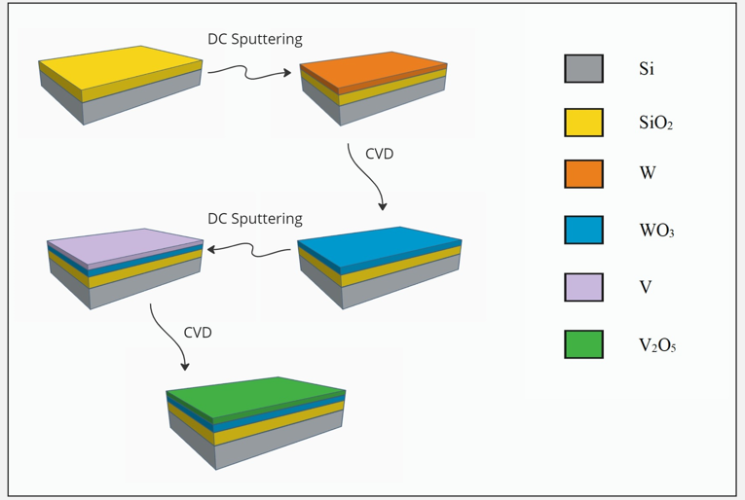
Flowchart

Slide 8
Graphs

Slide 9
Graphs

Slide 10
Graphs

Slide 11




Applications
Memory
Neuromorphic Computing
Adaptive Electronics
Internet of Things
Memristors can be used as non-volatile memory elements with high density, fast switching, and low power operation.
The synaptic behavior of memristors enables brain-inspired computing architectures for efficient data processing.
Memristors can be integrated into adaptive and reconfigurable electronic systems with self-learning capabilities.
Compact and energy-efficient memristor-based devices can enable advanced IoT applications at the network edge.

Slide 12

Conclusion
1
Promising Results
2
Impact on Future Electronics
The V2O5 and WO3 based memristors have shown promising results in terms of their switching behavior, endurance, and potential for scaling.
Continued research and development in this area could lead to the integration of memristors into next-generation electronic devices, enabling more efficient and versatile technology.
3
Continued Exploration
Further exploration of the fundamental properties and practical applications of memristors is essential to unlocking their full potential.

Slide 13

Future Work
Optimization
1
Further optimize the fabrication process to improve the performance and reliability of the memristor devices.
2
Scalability
Investigate the scalability of the memristor technology and explore its potential for integration into larger circuit systems.
Novel Applications
3
Explore novel applications of memristors, such as in neuromorphic computing and energy-efficient data storage.

Slide 14
Thank You

